Slide 1
AguaClara in Colombia
Team LFEM
Fletcher Chapin, Erica Marroquin, Lilly Mendoza

Slide 2
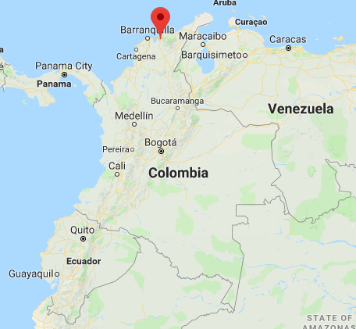
Introduction
Our goal was to draft an AguaClara treatment plant in Santa Rosalía, Columbia
We worked with Alejandra, a student of Javeriana University in Bogotá, Columbia to estimate plant parameters

Slide 3
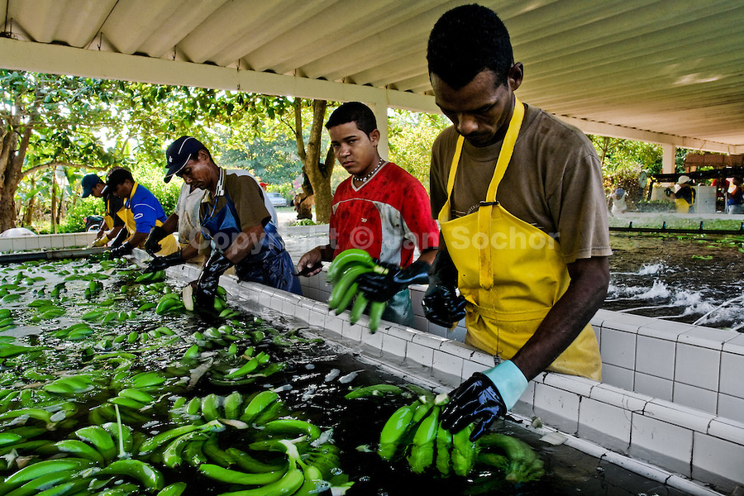
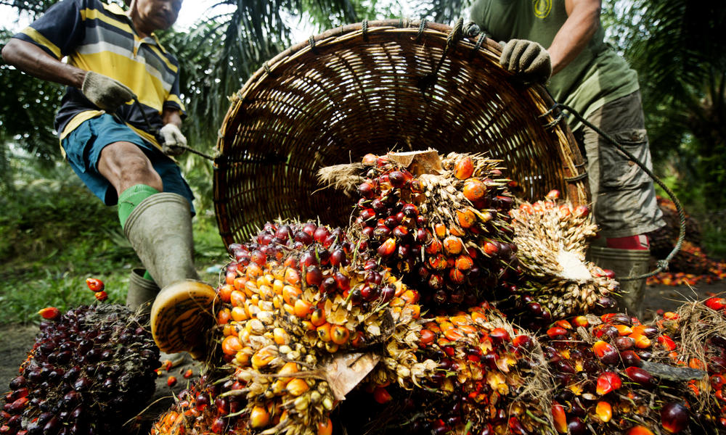
Current Situation
Santa Rosalía is located in La Zona Banana
4th largest producer of palm oil
Community aqueducts are controlled by municipalities
Water treatment in place but its technology is too advanced for town operators
Notes:
Banana image- https://goo.gl/images/kFNPwy
Palm oil image - https://goo.gl/images/NtNw22

Slide 4

Issues Surrounding Project
Lack of education on responsible water use
Knowledge on how to handle and operate filters and chlorination
Unknown water quality of mountain and treated water
Unknown demand for water
Supply of treated water is limited to 4 hours due to water storage
Notes:
- Because the supply system is successful, neighboring populations are proposing to make derivations of the existing aqueduct to supply its residents. This can greatly affect the current system if adequate studies are not done
-

Slide 5
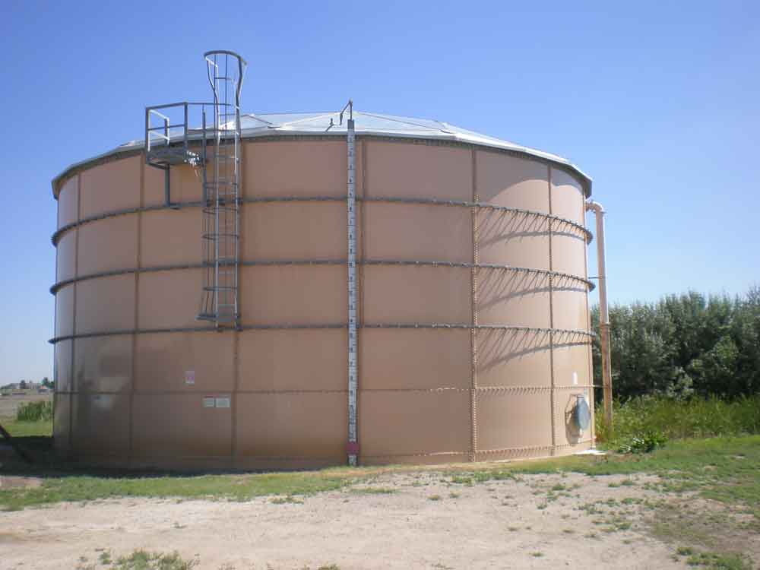
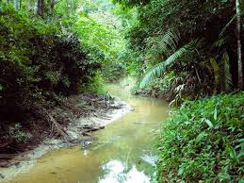
Proposed Solution
Increase capacity of the storage tank
Estimate the demand of clean water
Use the AguaClara design engine to create draft design
Notes:
- Possibly install it ASAP to monitor water quality and compare it to a typical AguaClara plant. This could then be used in the promotional fundraising materials.
Storage tank- https://goo.gl/images/P32yJy
Stream- https://goo.gl/images/MRxg3h

Slide 6
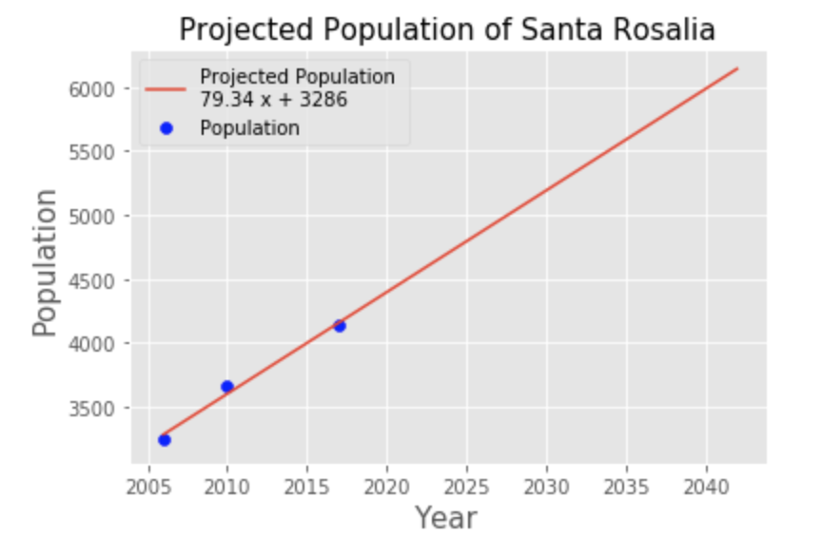
Estimating Design Constraints
Used 3.38 mL/s per person
This is based on Santa Rosalia’s current population of 4138 people and usage of ~14 L/s
Projected twenty years ahead, population will be around 6200 people requiring 20.78 L/s

Slide 7
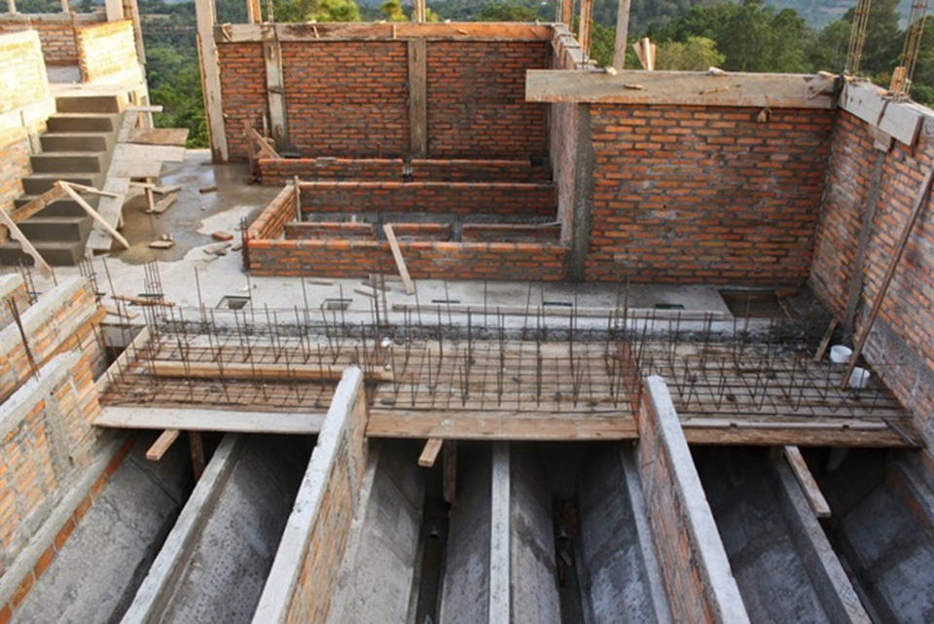
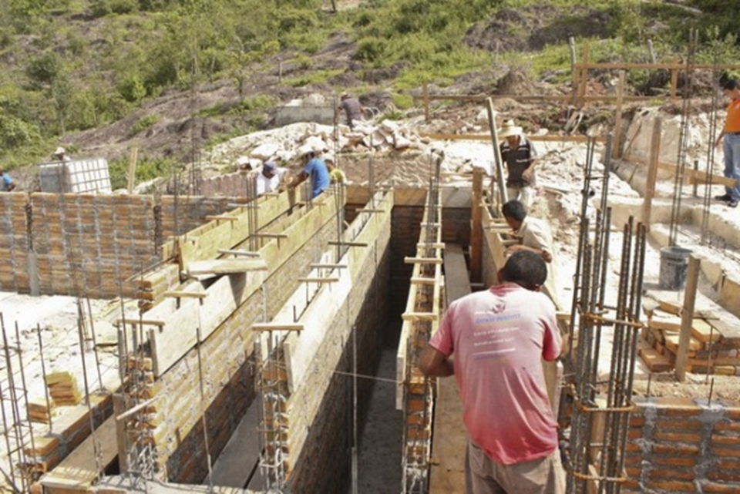
Building Codes and Wall Thickness
Typical AguaClara building practice of using bricks, rebar, and mortar to assemble the walls of the "skeleton" of the plant
Made the assumption of 15 cm, due to this being the usual wall thickness for AguaClara plants

Slide 8
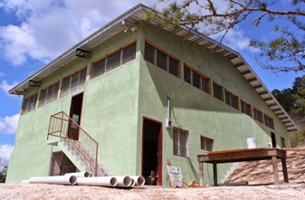
Storage Tank
Due to storage capacity, the current plant can only provide treated water for 4 hours a day
Current tank is 10,000 L
Using expected future population, the storage tank would need a capacity of 598450 L
Notes:
-According to the Title B Colombian Drinking Water Regulations², a water storage tank needs to be 1/3 of minimum daily water usage. Also using Title B, the assumption is that each person uses 150 L/day. Daily water usage, using the current population of 4138, would be 620,700 L/day. A third of this is 206,900 L/day. This storage tank is far too small for the current population.

Slide 9
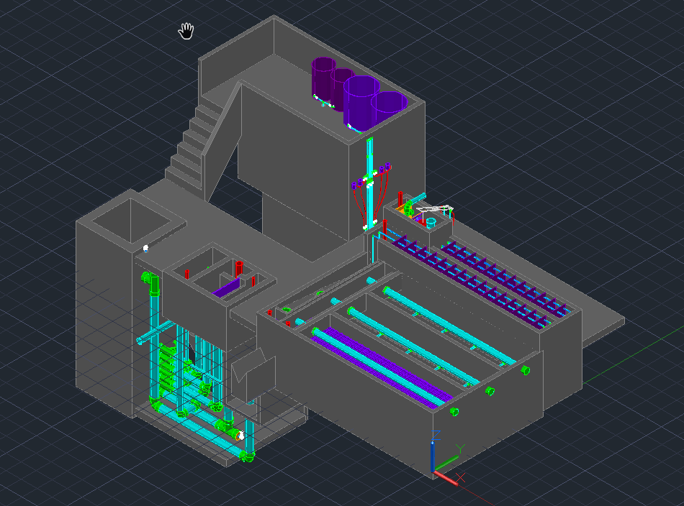
First Iteration of Draft Design

Slide 10
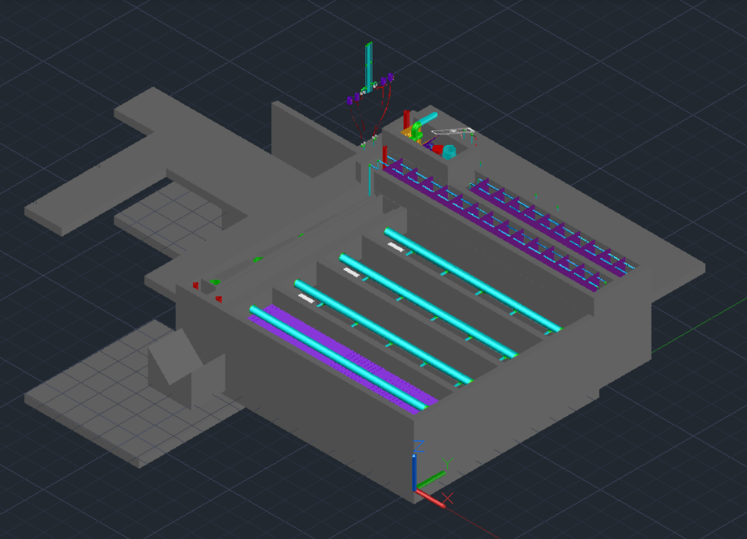
Second Iteration of Draft Design

Slide 11

Cost Estimate
Capital costs were estimated as $50000 + $8000/(L/s)
Operating costs were estimated to be $5/person/year
Amortizing the capital costs over 25 years, we arrived at a cost of $39,359/year
This is only $6.41 per person per year!

Slide 12


Future Steps
The team will look into outside funding sources
a "Crowdfunding" campaign could be used
An NGO similar to Agua Para el Pueblo will need to be contacted to see the feasibility of increasing the size of the storage tank

